Slide 1
Cloth

Slide 2
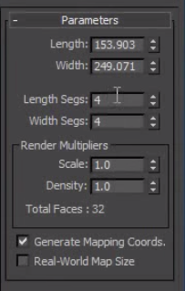
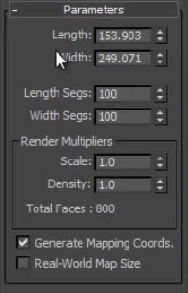
Realism

Slide 3
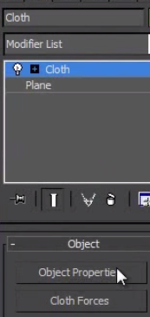
Cloth Modifier

Slide 4
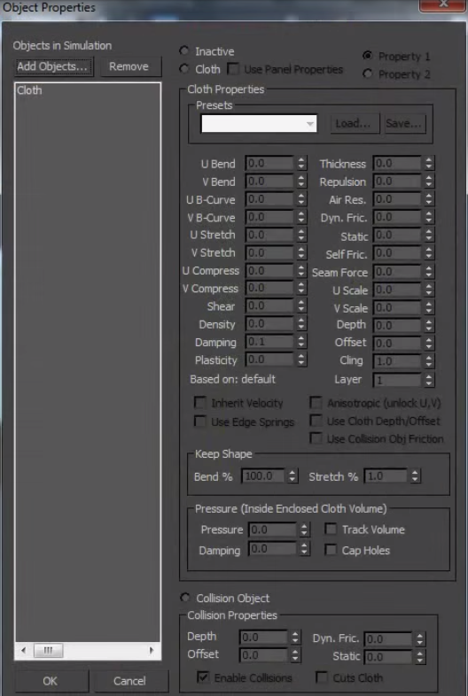
Object Properties

Slide 5
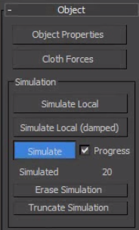
Simulation

Slide 6
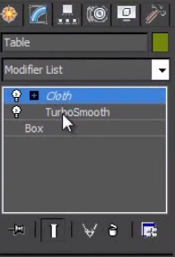
Paper Cuts

Slide 7
Spline, Garment Maker & Cloth
Garment Maker – creates a patch from your splines
Cloth Modifier – simulate your cloth; you can also use mcloth

Slide 8
Create a silhouette of your garment via splines
Duplicate your silhouette and attach them
Go to line modifier and use vertices mode
Select vertices and hit break
Now go to garment maker and panel mode
Rotate one of your silhouettes to a complete 180 and put one of them behind your model
Now go to seams modes click your splines on both silhouettes and create seams
If doesn’t work just increase seam tollerance

Slide 9
Now add the cloth modifier
Now add objects for collision in object properties
Now add our dress as cloth in object properties
Use spandex as material as it conforms nicely
Simulate local
Uncheck sewing springs under simulation parameters then click simulate local again

Slide 10
Edit poly modifier our dress and go to vertices mode.
What were doing is welding our dress
Deselect vertices that doesn’t need to be welded
Then right click and weld
Then change the weld option parameter

Slide 11
Now for the collision mesh add MassFx RigidBody Modifier
We now have a geometry added for bounding box
Set rigid body property as static and physical shape type as original

Slide 12
Back to our cloth we need it to be dynamic for our mcloth
We can now adjust our physical fabric properties for animation
Make sure we have collide to rigid objects checked

